Slide 1




NEXT GEN EMPLOYABILITY PROGRAM
Creating a future-ready workforce
Team Members
College Name
Student Name : S. DAYANA
Student ID : au511321104015
Kingston Engineering College

Slide 2

CAPSTONE PROJECT SHOWCASE
Project Title
Building Bus Reservation System using Python and Django
Abstract | Problem Statement | Project Overview | Proposed Solution | Technology Used | Modelling & Results | Conclusion

Slide 3
Abstract : This project aims to develop a Bus Reservation System utilizing Python programming language and the Django web framework. The system is designed to facilitate efficient booking and management of bus tickets for passengers, providing an intuitive interface for both users and administrators. The development process involves utilizing Python for backend logic and Django for creating the web application framework. Django's built-in features such as ORM (Object-Relational Mapping), authentication system, and admin interface streamline the development process, enabling rapid prototyping and deployment. The Bus Reservation System offers several benefits, including convenience for passengers, improved efficiency in ticket management, and enhanced revenue generation for bus operators. Additionally, the system can be easily scaled and customized to meet the specific requirements of different bus companies or operators. Thus the development of the Bus Reservation System using Python and Django presents a comprehensive solution for managing bus bookings effectively, catering to the needs of both passengers and administrators in the transportation industry.
Source :

Slide 4
Problem Statement : The current process of booking bus tickets is often cumbersome and inefficient, characterized by long queues at ticket counters, limited availability of seats, and manual paperwork for both passengers and bus operators. The system will provide a user-friendly platform for passengers to search, book, and manage their bus tickets conveniently online. Furthermore, it will offer comprehensive management features for bus operators/administrators to efficiently handle route scheduling, seat allocation, and booking management. Key challenges to be addressed by the Bus Reservation System include: Inefficient Booking Process Limited Seat Visibility Manual Management Lack of Data Analysis Security and Reliability By addressing these challenges, the Bus Reservation System aims to revolutionize the bus ticketing experience, making it more convenient for passengers while empowering bus operators with tools for efficient management and optimization of their services.
Source :

Slide 5
Project Overview : The Bus Reservation System project aims to develop a robust web-based application using Python and Django to modernize the bus ticketing process. This system will cater to the needs of passengers and bus operators alike, providing a seamless booking experience and efficient management tools. Convenience: Provides a user-friendly platform that simplifies the booking process for passengers, saving time and effort. Efficiency: Streamlines route management and booking administration processes, improving operational efficiency for bus operators. Insights: Offers valuable insights into booking patterns and performance metrics, enabling administrators to make data-driven decisions and improve service quality. Scalability: Designed to be scalable and customizable to accommodate the specific needs and requirements of different bus operators and users. Thus the Bus Reservation System project aims to deliver a comprehensive and efficient solution that enhances the bus ticketing experience for both passengers and operators, ultimately contributing to the improvement of the transportation industry as a whole.
Source :

Slide 6
Proposed Solution : The Bus Reservation System project will implement a modern, user-friendly web application using Python and Django to revolutionize the bus ticketing process. The proposed solution will address the challenges faced by passengers and bus operators, providing a seamless booking experience and efficient management tools. Key Components of the Proposed Solution: 1. User Authentication and Registration : Implement secure user authentication and registration functionalities using Django's built-in authentication system. Utilize encryption techniques to ensure the confidentiality and integrity of user credentials and personal information. 2. Bus Route Management : Develop an intuitive admin interface for bus operators to define and manage bus routes, schedules, fares, and available seats. Utilize Django's ORM to store and manage route data efficiently, ensuring scalability and flexibility. 3. Ticket Booking : Design a user-friendly interface for passengers to search for buses based on routes, dates, and times. Implement real-time availability updates using AJAX to provide a seamless booking experience.
Source :
.

Slide 7
4.Seat Selection : Develop an interactive seat selection interface using JavaScript and HTML/CSS to allow passengers to choose their preferred seats. Integrate bus layout visualization to enhance user experience and facilitate informed seat selection.
5.Payment Integration : Integrate with popular payment gateways such as Stripe or PayPal to enable secure online transactions. Implement SSL encryption and tokenization techniques to safeguard sensitive payment information.
6.Booking Management : Provide users with a dashboard to view and manage their bookings, including options for cancellations and modifications. Develop an admin dashboard with comprehensive booking management features, including filtering, sorting, and exporting capabilities.
7.Reporting and Analytics : Implement reporting and analytics functionalities to generate insights into booking trends, revenue generation, and route performance. Utilize Django's built-in support for data analysis libraries such as pandas and matplotlib for generating visualizations and reports.
Source :

Slide 8
8.Scalability and Performance Optimization : Design the system with scalability in mind to handle increased user traffic and data volume. Utilize caching mechanisms, database indexing, and asynchronous processing to optimize system performance.
9.Documentation and Testing : Provide comprehensive documentation for installation, configuration, and usage of the system. Implement unit tests, integration tests, and end-to-end tests to ensure the reliability and correctness of the system.
In summary, the proposed solution for the Bus Reservation System project will leverage the capabilities of Python and Django to develop a robust, secure, and user-friendly web application that meets the requirements of both passengers and bus operators. By following best practices in software development, security, and performance optimization, the system will provide an efficient and enjoyable booking experience for users while offering powerful management tools for bus operators.
Source :

Slide 9


Technology Used
Front-end
Back-end
Source :

Slide 10
Modelling & Results : This ERD provides a visual representation of the database structure for the Bus Reservation System project. It outlines the entities, attributes, and relationships that will be implemented in the database schema using Django's ORM. This modeling process serves as a foundation for developing the backend logic and functionalities of the system. User: Represents users of the system. This entity stores information such as user ID, username, email, password (hashed), and other relevant details. Bus: Represents individual buses. This entity stores information about each bus, such as bus ID, registration number, model, capacity, and any other relevant details. Route: Represents bus routes. This entity stores information about each route, including route ID, origin, destination, distance, and duration. Booking: Represents bookings made by users. This entity stores information about each booking, including booking ID, user ID, bus ID ,route ID , booking date, departure date, and any other relevant details. Seat: Represents individual seats on buses. This entity stores information about each seat, such as seat number, bus ID (foreign key), availability status, and any other relevant details. The result of the Bus Reservation System project is a comprehensive solution that enhances the bus ticketing experience for both passengers and operators. It simplifies the booking process, improves operational efficiency, and provides valuable insights for informed decision-making.
Source :

Slide 11
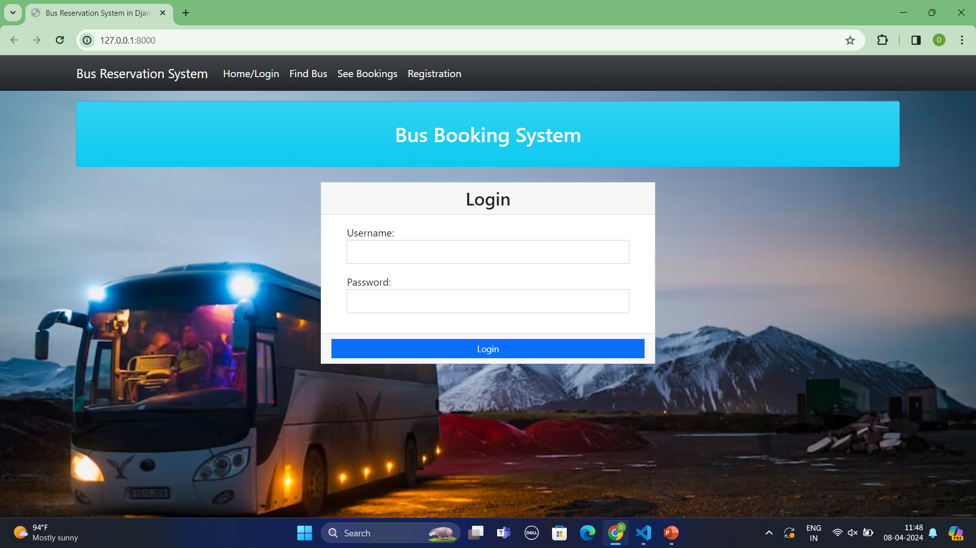
Homepage

Slide 12
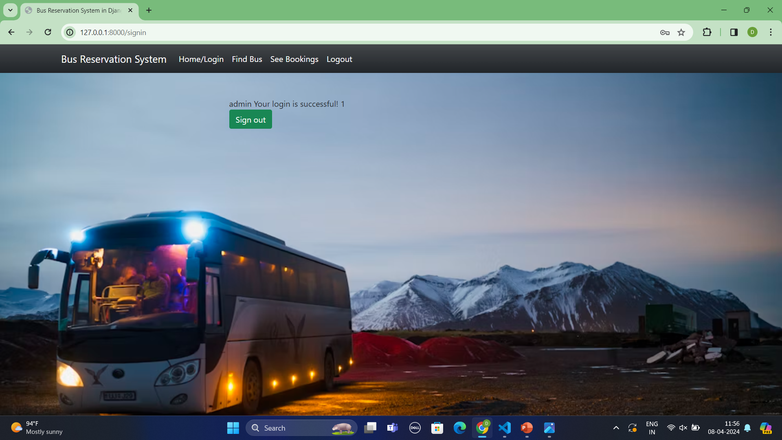
About-Us-Page

Slide 13
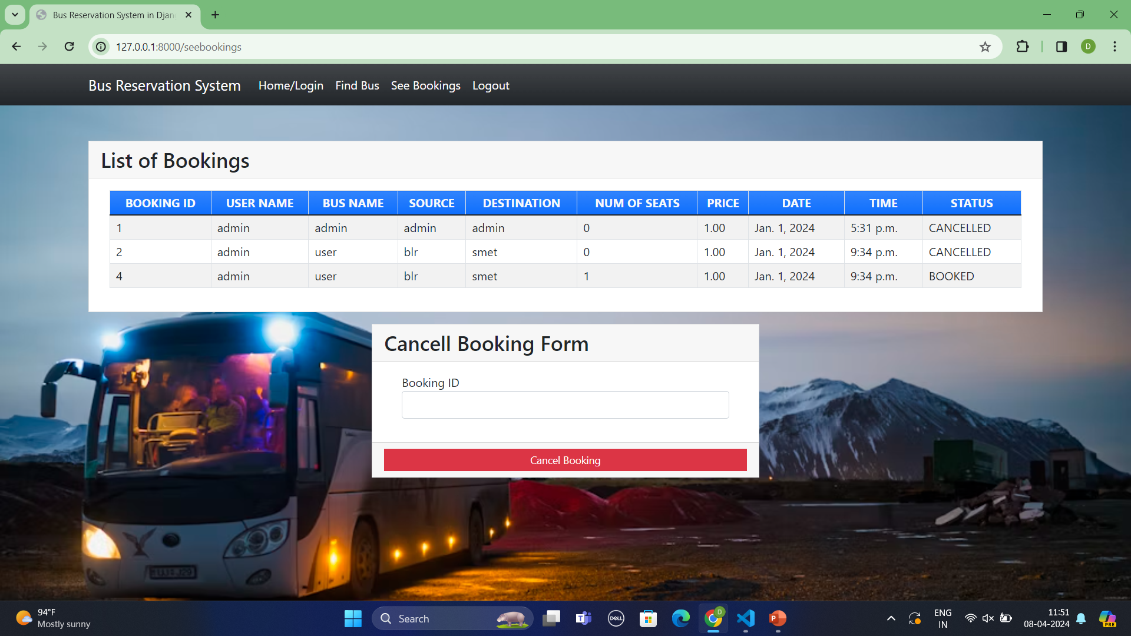
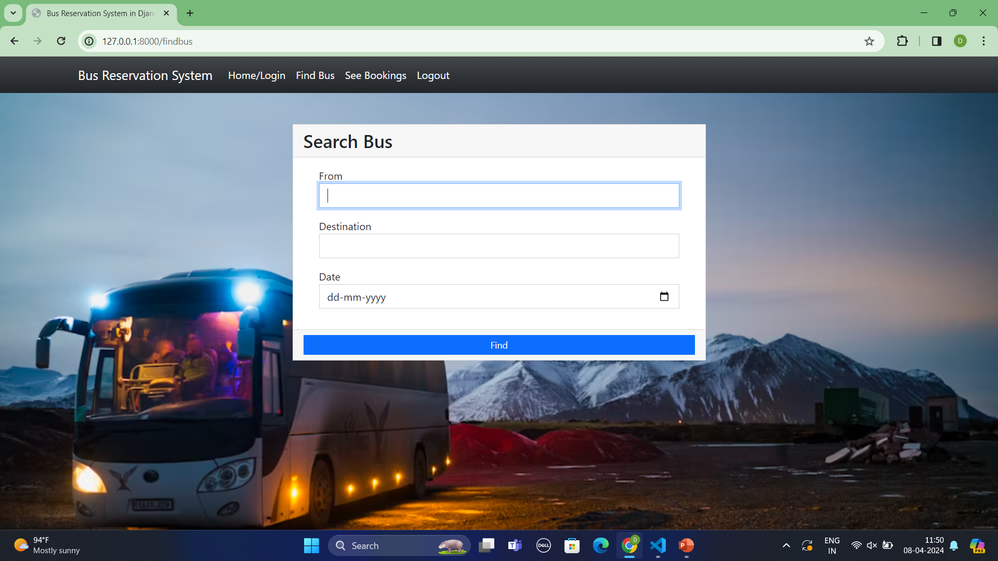
Service-Page

Slide 14
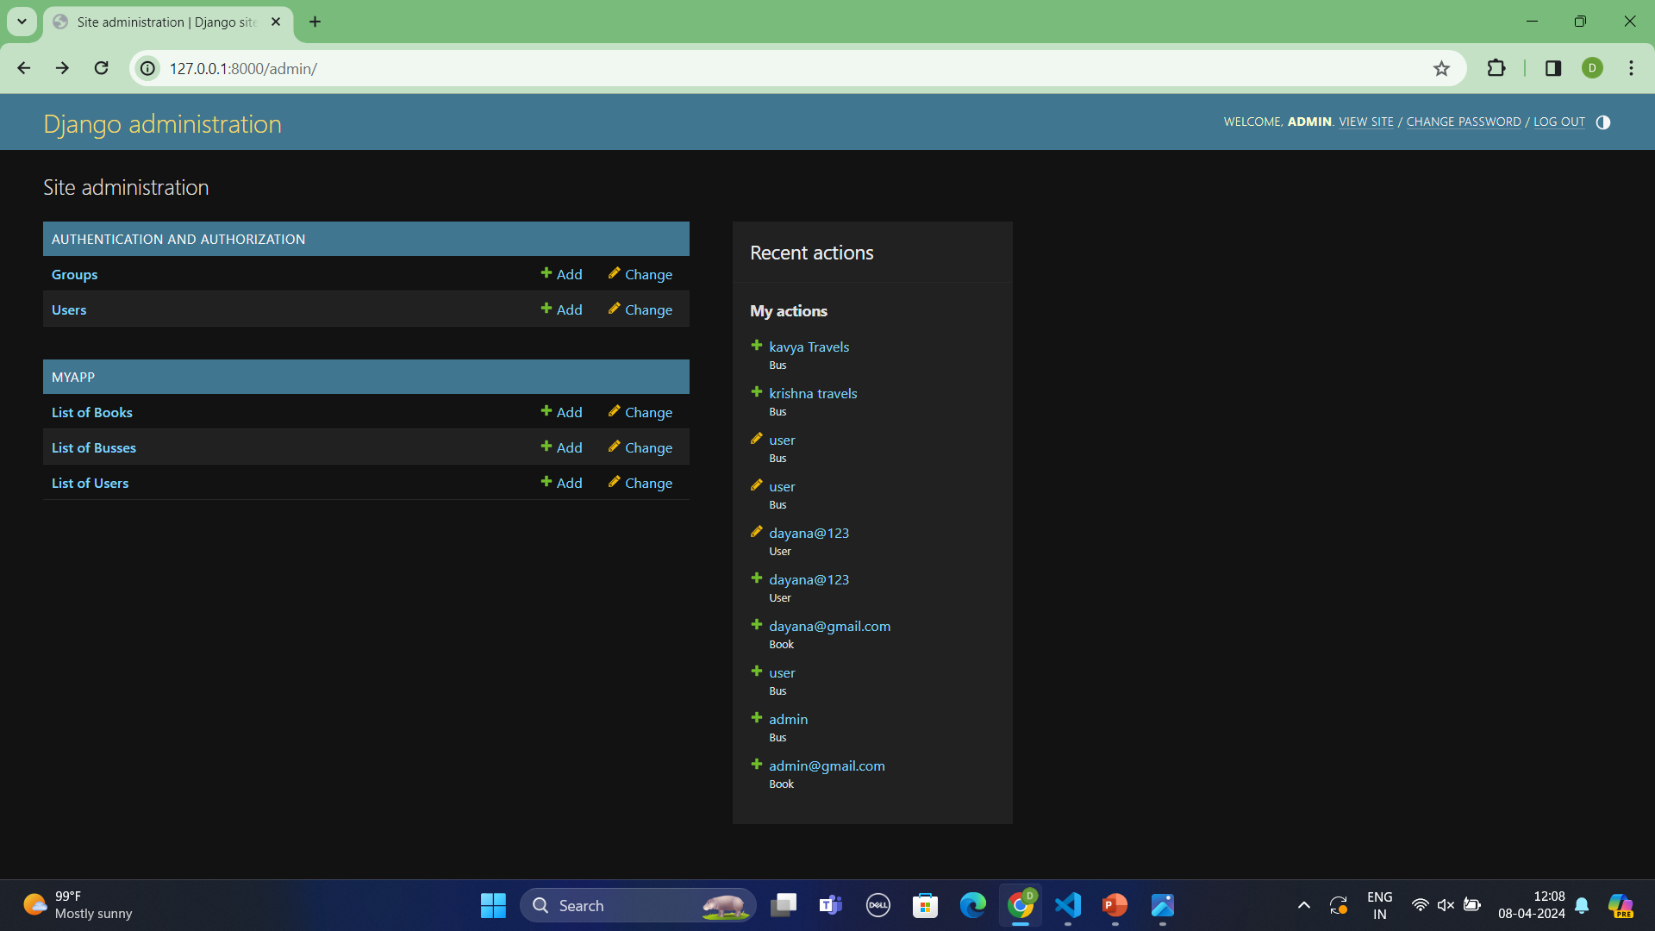
Departments-Page

Slide 15
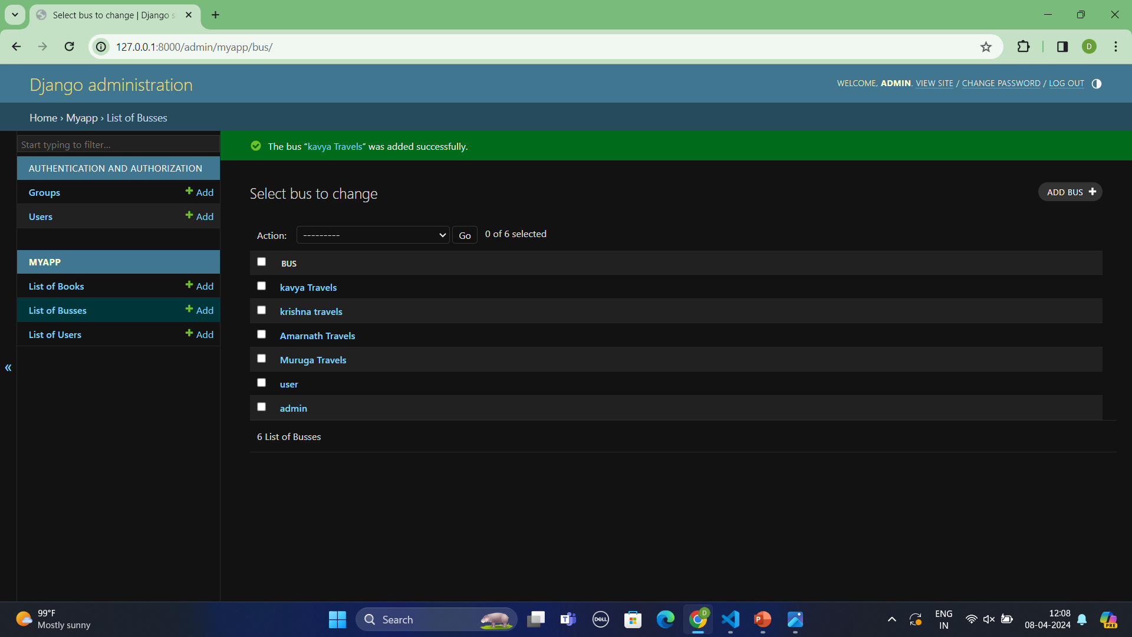
Blog-Page

Slide 16
Future Enhancements :
Future Enhancements for the Bus Reservation System:
Mobile Application Development: Develop a mobile app version of the system to cater to users who prefer booking tickets on their smartphones. This would enhance accessibility and convenience for passengers.
Real-Time Bus Tracking: Integrate GPS technology to enable real-time bus tracking for passengers. This feature would allow users to track the location and estimated arrival time of their booked buses.
Social Media Integration: Integrate social media platforms to allow users to share their booking experiences, promote the system, and attract new users through word-of-mouth referrals.
Enhanced Security Measures: Continuously update and enhance security measures to protect user data and transactions from emerging threats, such as implementing multi-factor authentication and regular security audits.
These future enhancements would further enrich the functionality and user experience of the Bus Reservation System, ensuring its continued relevance and competitiveness in the transportation industry.

Slide 17
Conclusion : In conclusion, the development of the Bus Reservation System using Python and Django presents a significant opportunity to revolutionize the bus ticketing experience for both passengers and bus operators. Through the implementation of robust features such as user authentication, bus route management, ticket booking, seat selection, payment integration, booking management, reporting, and analytics, the system streamlines the entire booking process, enhances operational efficiency, and provides valuable insights for informed decision-making . The project's modeling, encompassing the entities, relationships, and data flow, lays the foundation for a well-structured and efficient system design. This modeling approach ensures proper organization and management of data, facilitating scalability, flexibility, and maintainability. The Bus Reservation System project represents a comprehensive solution that addresses the challenges faced in traditional bus ticketing processes. By leveraging the power of Python and Django, coupled with thoughtful design, implementation, and future enhancements, the system promises to deliver convenience, efficiency, and value to both passengers and bus operators, ultimately contributing to the advancement of the transportation industry as a whole.
Source :

Slide 18
Thank You!
Notes:
Thank You !!

